Slide 1

Send money securely and quickly to anyone, anywhere in the world.

Slide 2


Expensive – international remittance is the lively hood of millions of families worldwide; transaction fees can take large fees from much needed money.
Long Wait Times – long transaction wait times mean that families must wait for necessary remittance payments for what can sometimes be an indeterminate amount of time.
Accessibility – banks and money cashiers maintain a hold on the international remittance industry.
Problem

Slide 3
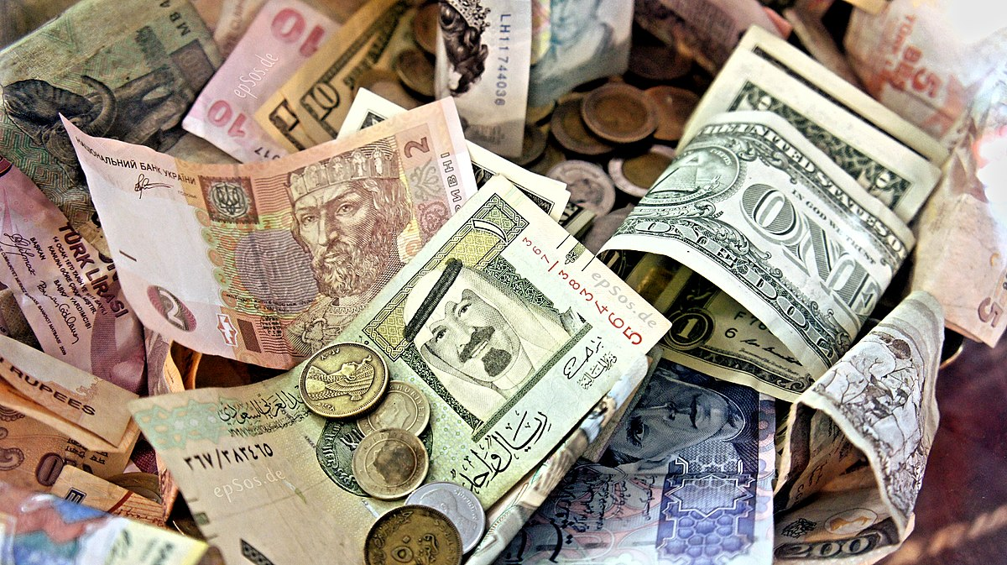





Solution
A mobile application with a web-based dashboard, where users can send money securely and quickly to anywhere.
Currency converter
Ensure you send money using
current exchange rates.
Social Component
Find friends, send or
request money, and send
thank you notes
Use Blockchain Tech
Use blockchain technology
to send payments anywhere
to anyone

Slide 4
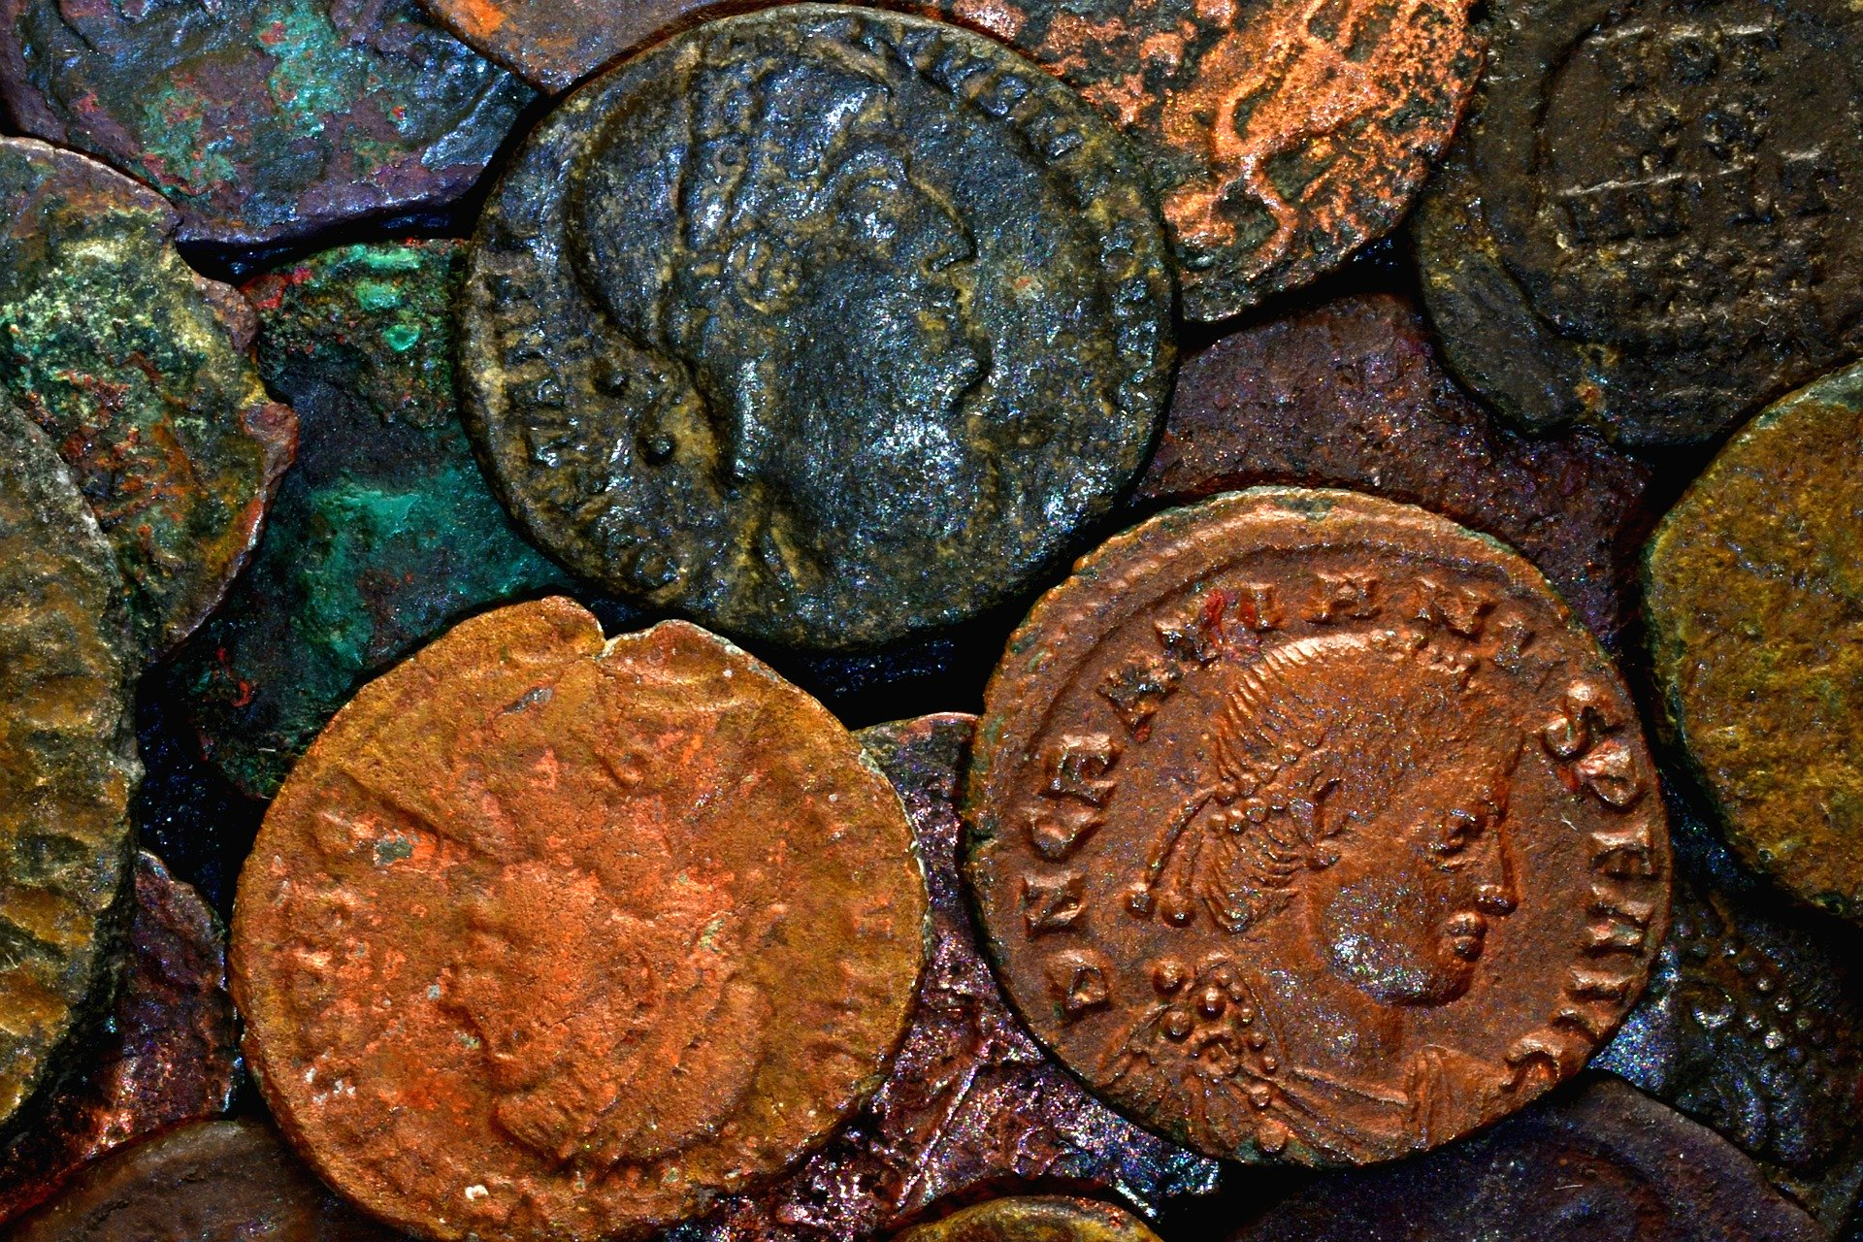

Market Validation
Venmo
Cash App
52 million
total users*
$17 million
Q4 net income**
These now household names only allow users to complete transactions in the US.
*As reported by forbes.com
**As reported by marketwatch.com

Slide 5
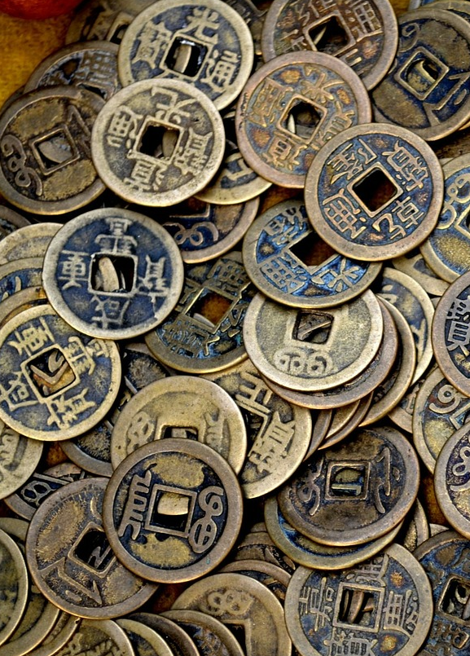
Market Size
World Bank*
$550 Billion+
Worldwide remittance payments in 2019 up 9.6% over 2018
$500 average payment **
India and China make up over $100 billion in remittances payments
KNOMAD***
Remittances are on track to become
the largest source of external
financing in developing countries.
*As reported by worldbank.com
**As reported by moneyandbanking.com
***As reported by knomad.org

Slide 6

Product

Slide 7

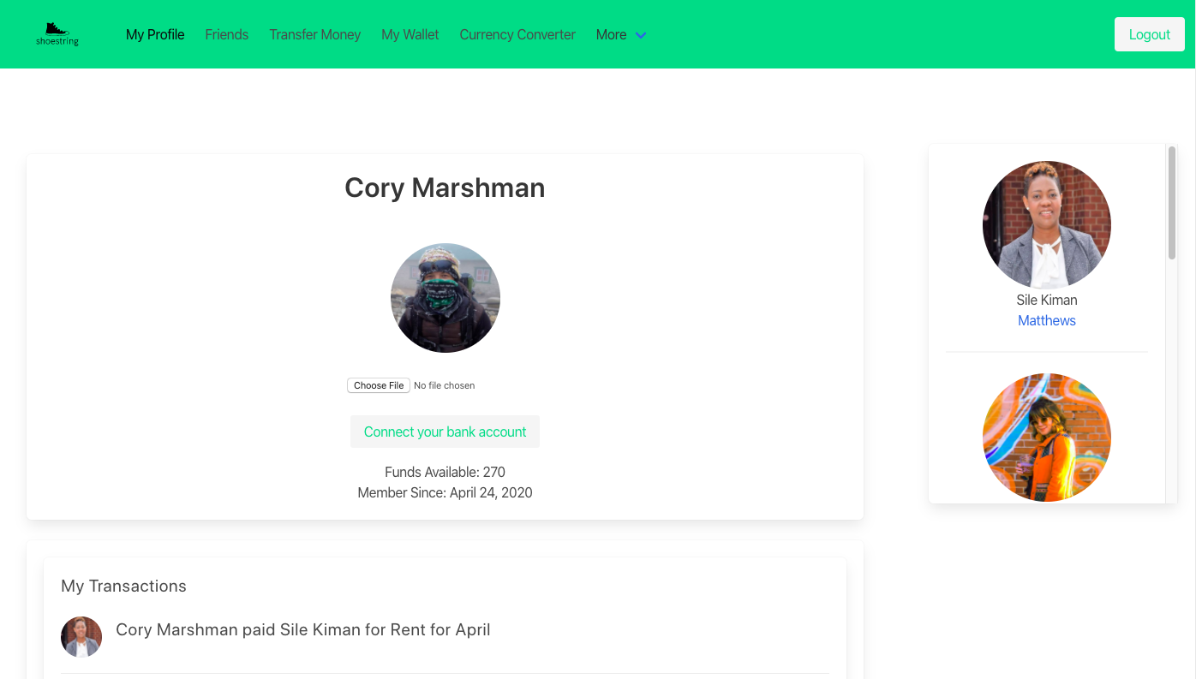
User dashboard

Slide 8
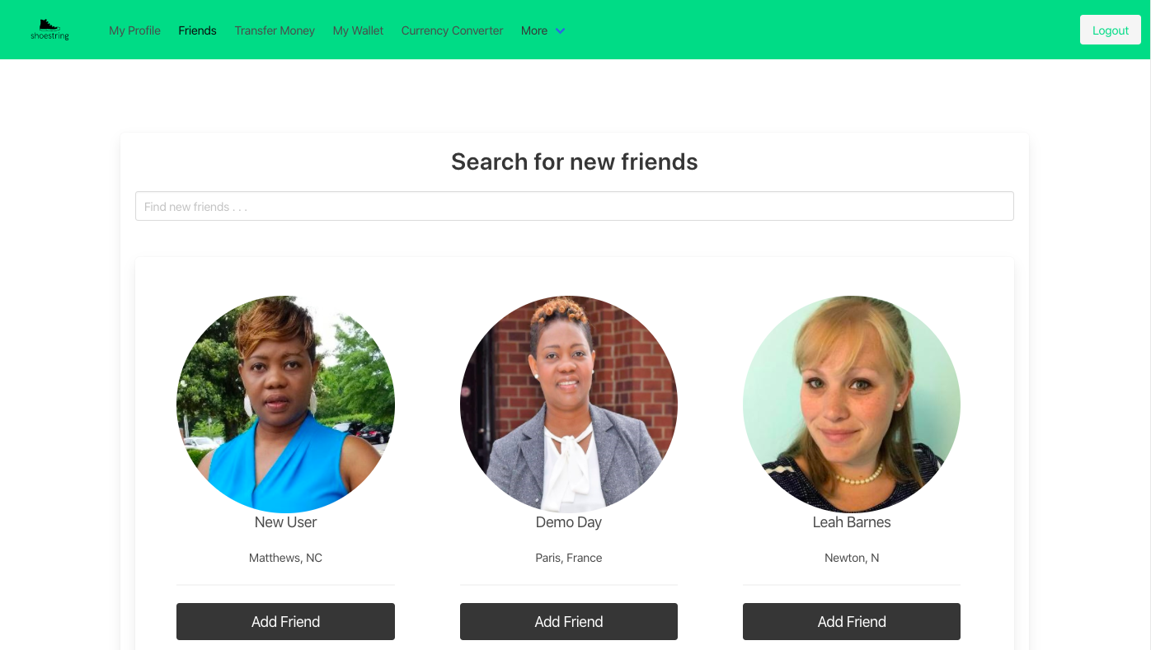
Interactive Profile

Slide 9
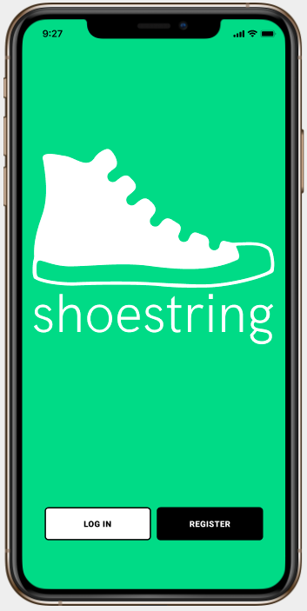
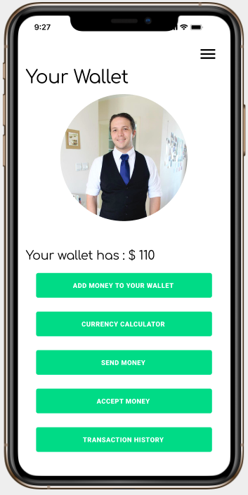
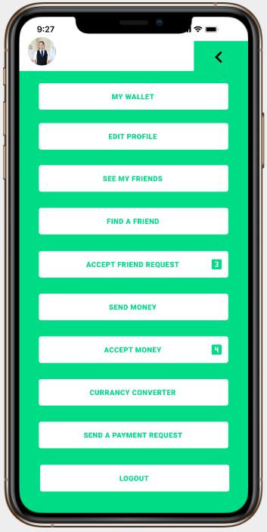
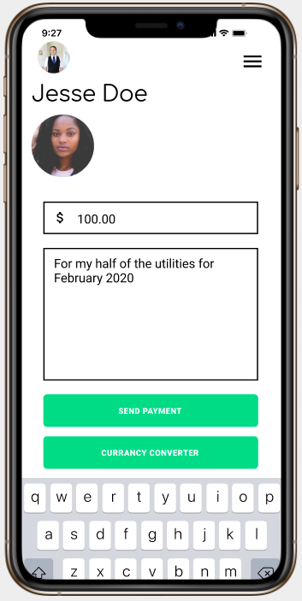
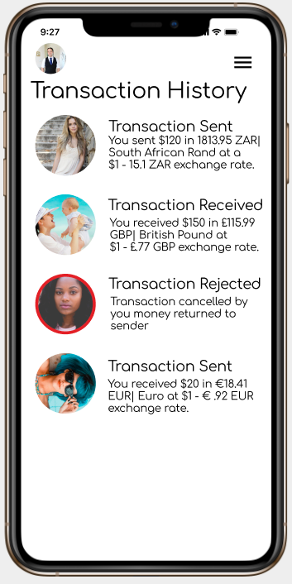
Mobile App

Slide 10
Business Model
Our application works off free and paid product offering
Free Products
Paid Products
Download the app from Google play and Apple app stores, access the web dashboard and set up an account.
Local transactions (with in the same country or monetary block (EMU)) by linking your bank account
Additional app features:
Transaction tracking
Live Currency Converter
Social Component, Find and communicate with Friends
Credit Card Usages
Users credit card instead of a bank account
Transactions are 2.9%
International Transfers
Transactions take a 3% commission
We do not take commissions on currency conversion. Currency conversion is live updated
Instant account to bank transfers
Instantly transfer from user dashboard to bank account with a 0.9% fee per transaction
Users can pull instantly from their bank account for free.

Slide 11




The Founders
DeVante Bailey
CSO
Cory Marshman
CEO
Sile Kiman
CIO
JT Turner
CPO
Developer with a background in logistics, business relationship and 3rd party API’s. Manges Shoestring’s external business relationships.
Team Role: CSO and 3rd Party API management
Project manager with 10+ years of experience, having managed multiple multi-million-dollar projects from concept to market launch.
Team Role: CEO and Mobile Application
10 years as a Technical Software Analyst with a new focus on building functional applications. Built and manages Shoestrings database.
Team Role: CIO and Database
Developer with a background in Graphic Communications, who blinds design and coding to develop beautiful applications
Team Role: Head of Product and Design Guru

Slide 12
Financial
We are looking for initial pre-seed funding to take our company through MVP to launch within the next 12 months
$40k
Pre-seed Round 5-7% equity stake
50 users
MVP Launch 1st 50 users
Business Mentor
To help set us up for success.

Slide 13
6 months – By November 1st a working MVP with all legal money changing, management managing and any corresponding SEC certifications to
8 – 10 months – By January 1st a soft launch of the app to 50 select social media influencers across 5 countries for testing and daily use.
10 – 12 months – full launch with the assistance of social media influencers to full launch across 5 countries.
12 – 18 months – expanded launch across 15 countries
18 – 24 months –expanded launch across 25 countries
36 months – expanded launch across 50 countries
Milestones

